Slide 1


SMART INDIA HACKATHON 2024
BEACH CLEANING MACHINE
Problem Statement ID –SIH1532
Problem Statement Title- Student Innovation
Theme- Clean and Green Technology
PS Category- Hardware
Team ID-
Team Name- Future Minds

Slide 2
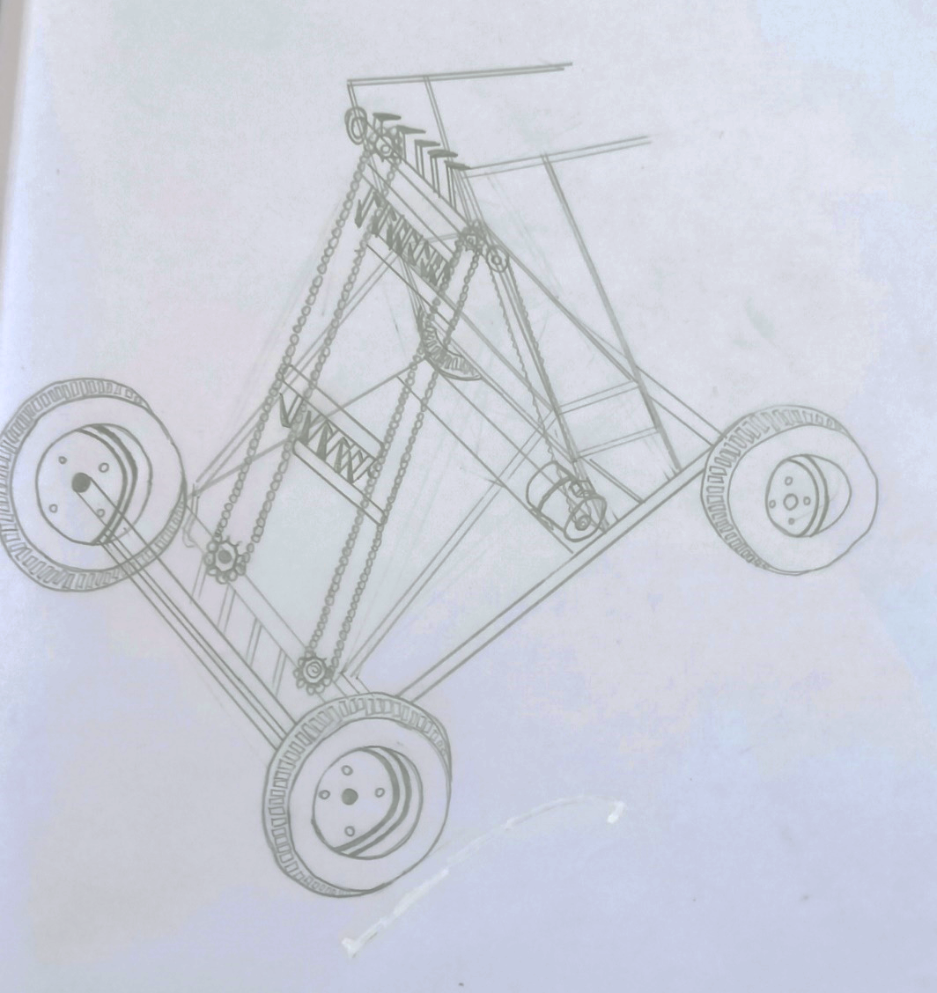
BEACH CLEANING MACHINE
Future Minds
Proposed Solution
Beach cleaning machine can remove materials ranging in size from small pebbles, shards of glass to larger debris, like seaweed and driftwood, floating waste like bottles and plastic cans.
By keeping the sand on the beach and only lifting the debris, the machine can travel at high speeds.
Beach cleaner machines minimize manual labor while maximizing effectiveness.
It makes a beach clean at amulti-season investment for landscapers and other contractors.

Slide 3
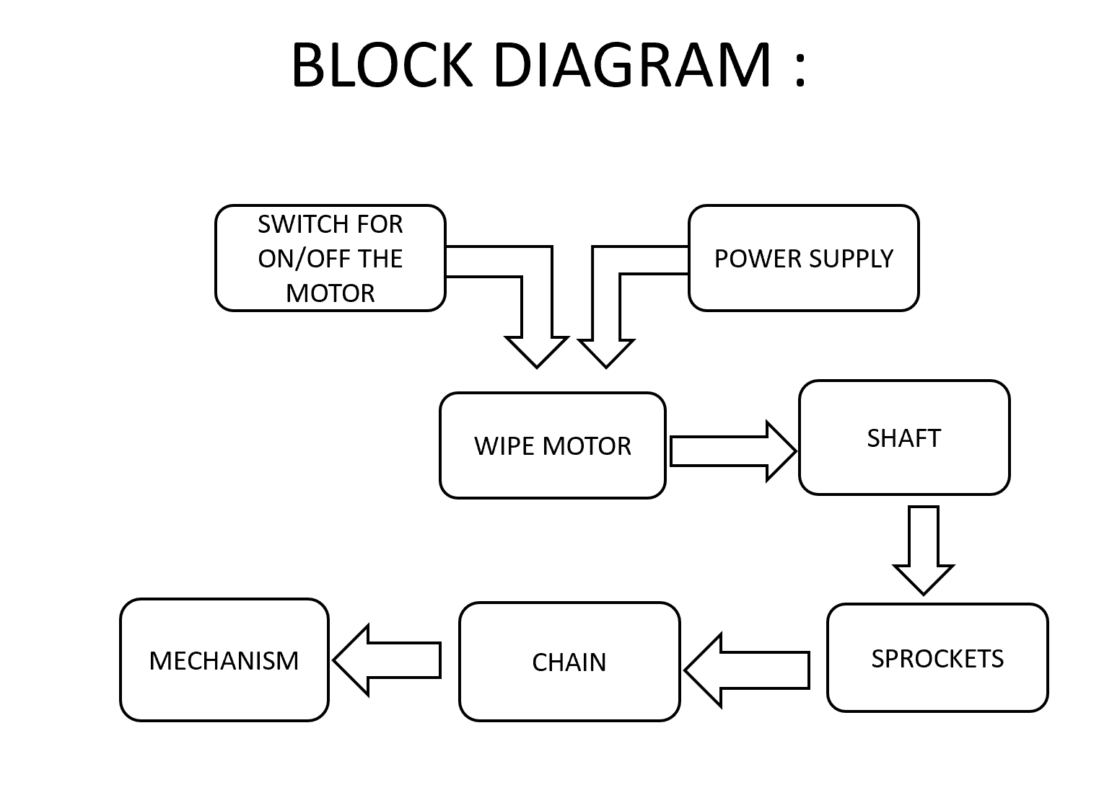
TECHNICAL APPROACH
Future Minds
Dimensions : Length_1.2m-1.7m, Width_0.7m-0.9m, Height_0.7m-1.0m
Frame : Aluminium or mild steel
Balloon Tires : Set of 4 Conveyor
Mechanism : Plastic or metal mesh Sprockets, chains, or belts
Motor & Battery : 12V DC motor12V battery PWM motor speed controller Sensors (for object detection and navigation)
Ultrasonic sensors : 2–4 sensors
Camera AI & Processing Unit : Raspberry Pi or similar AI software/algorithms
Wheels & Axles : Axles and support structure Bearings Collection Bin : Plastic or metal bin
Total weight : 25 kgs
Total cost : 28,000/- approximately

Slide 4
FEASIBILITY AND VIABILITY
Future Minds
A beach-cleaning robot is feasible but faces several challenges, including handling diverse beach conditions, power sources, and navigation.
Cost and technical considerations also play a role.
For visibility, increasing public awareness through demonstrations, media coverage, and a well-designed robot can enhance its profile and acceptance.

Slide 5
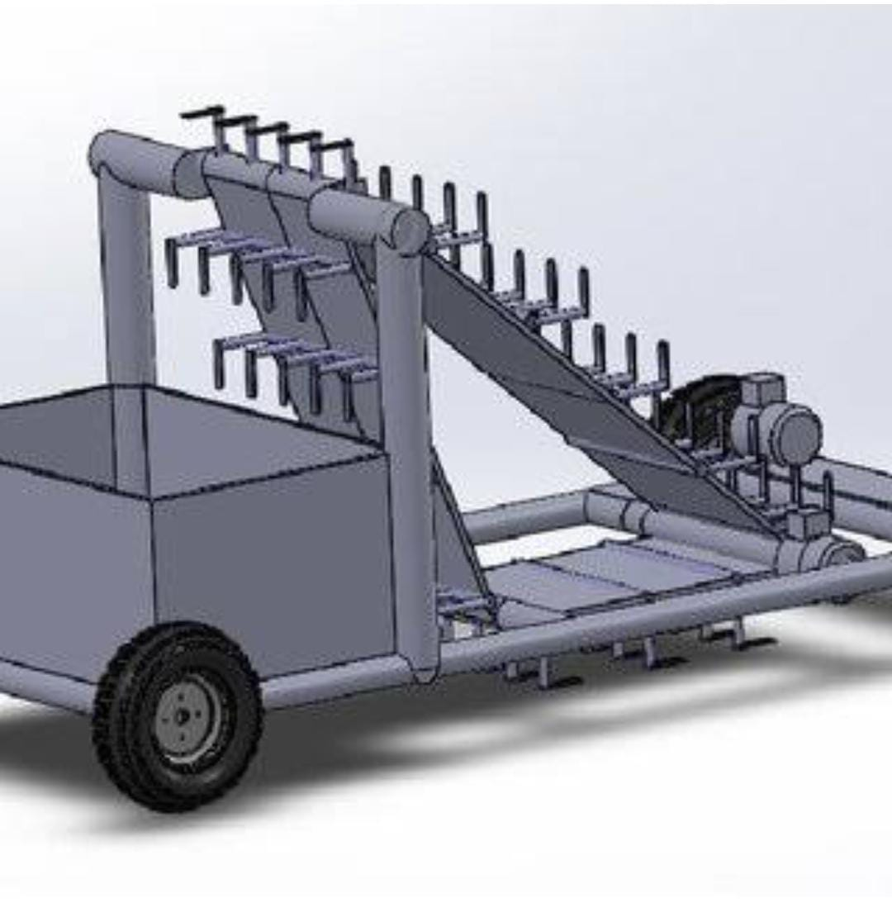
IMPACT AND BENEFITS
Future Minds
Benefits :
Environmental Protection
To improve marine life
Public Health and Safety
Preservation of Natural Habitats
Efficiency and Cost-Effectiveness
Impacts :
Harm to Small Organisms
Carbon Footprint
Disruption of Natural Processes

Slide 6
RESEARCH AND REFERENCES
Future Minds
Payas Deshpande, Omkar Milkhe, Ajinkya Kamble, Prof. Neha Kudu, BEACH CLEANING ROBOTSA COMPREHENSIVE SURVEY OF TECHNOLOGIES CHALLENGES, AND FUTURE DIRECTIONS, https://www.doi.org/10.56726/IRJMETS37666
Semi automated wireless beach cleaning robot vehicle, 2019, 22773878, International Journal of
Recent Technology and Engineering vol 8 issue 1, M. Bhavani, S. Kalaiselvan, S. Jagan, S. Gopinath.
"Design and Development of a Beach Cleaning Robot" by M. A. K. Al-Amin et al. (2020) – This paper presents a detailed mechanical design and functionality of a beach cleaning robot, focusing on its engineering challenges and solutions.
https://www.hbarber.com/beach-cleaning-machines/

